Slide 1
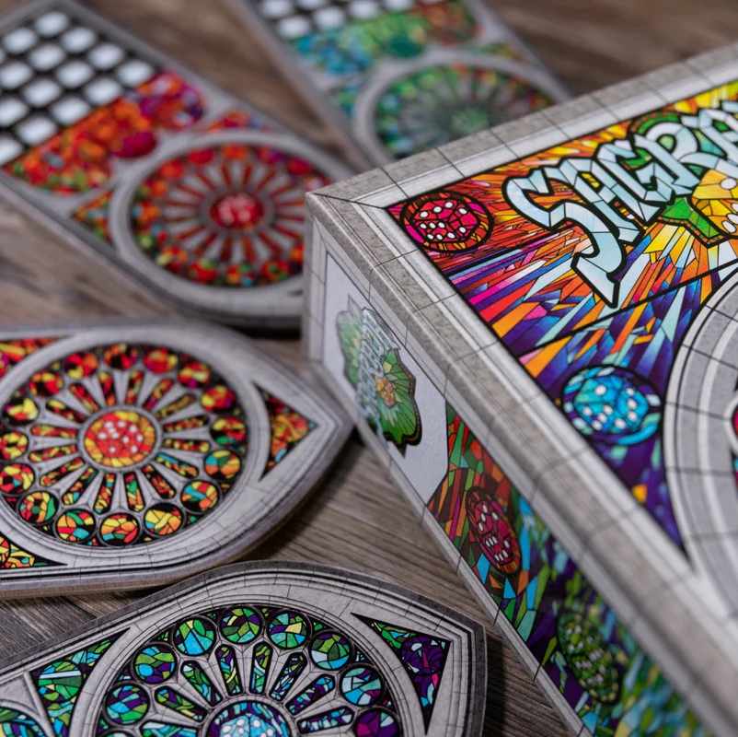
Programming Techniques 2024
Project: Sagrada

Slide 2
General Information
Each week a new milestone, which grants points for the final grade.
Each milestone has a deadline; if submitted later -> less points.
A submission is correct only if it implements completely and correctly the required features.
A submission is accepted only if the students can answer the questions asked by the tutor; if they cannot, the milestone implementation may be rejected and graded with 0.
For raising the final project grade, students have the possibility to request additional features to be implemented, subject to negotiation with the tutor.

Slide 3
Milestone 1: Introduction to the Game
What will happen during class?
Discuss the general rules of the game
Discuss game elements
Milestone requirements:
Read the game rules and make a written outline in natural language
Create a technical outline of identified features
Propose data structures to store relevant information
Deadline: week 4.
=> 1 point if completed correctly and completely (see slide 2).

Slide 4
Milestone 2: System State
What will happen during class?
Discuss the proposed data structures
Establish basic functions required to prepare the game
Milestone requirements:
Implement relevant functions and data structs for initializing:
Player window: read from configuration files the layout, helper gems, secret mission and public goals.
Dice bag: filled with all dice
Round marker: empty
Deadline: week 6.
=> 2 points if completed correctly and completely (see slide 2).

Slide 5
Milestone 3: Graphical User Interface
What will happen during class?
Discuss original boardgame design and how it can be translated into a simple user interface
Milestone requirements:
Implement a minimal user interface – creative freedom:
Show: player windows with restrictions and all dice that have been placed
Show: rolled dice pool – available for taking every round
Show: round marker
Debug: remaining dice in the bag
Deadline: week 8.
=> 1 point if completed correctly and completely (see slide 2).

Slide 6
Milestone 4: Round Structure
What will happen during class?
Discuss the events that occur during a round and establish the list of impacted components
Milestone requirements:
Implement the required functions for the following:
Take an appropriate number of dice from the bag and roll them, then place them in the pool.
End round and update marker; pass on first player.
Deadline: week 10.
=> 1 point if completed correctly and completely (see slide 2).

Slide 7
Milestone 5: Game Flow
What will happen during class?
Discuss the steps involved in a round and focus on game flow
Milestone requirements:
Add features to allow:
Players to take turns picking dice
Placing selected dice on a chosen location
Checking for a valid placement
Detect end of the round
Deadline: week 12.
=> 2 points if completed correctly and completely (see slide 2).

Slide 8
Milestone 6: Scoring
What will happen during class?
Discuss how the player board is evaluated at the end of the game
Milestone requirements:
Implement the required functions for the following:
Add points from the private mission
Add points from the public goals
Add points from gems.
Deadline: week 14.
=> 2 points if completed correctly and completely (see slide 2).

Slide 9
Week 14
What will happen during class?
Students may submit the last milestone and optional feature implementation to raise grades
Competition:
The authors of the best 4 implementations enter a tournament
Winner gains 3 bonus points which they may award to any student(s) within the group.

Slide 10
References
Official Sagrada Rulebook (pdf – available on Campus Virtual)
Sagrada Public Goal Evaluation Examples (pdf – available on Campus Virtual)
Short video tutorial on how to play the game:
https://www.youtube.com/watch?v=0JLpaGHL8MQ&ab_channel=WatchItPlayed
Short description and basic information about the game:
https://boardgamegeek.com/boardgame/199561/sagrada

Slide 11
Useful Information
Office Hours:
Monday 16-19 – B417
If you want to try out the physical boardgame
During office hours ☺

